Slide 1
Mid term project 2 (individual) Data modeling security
By Oliver Vidal

Slide 2
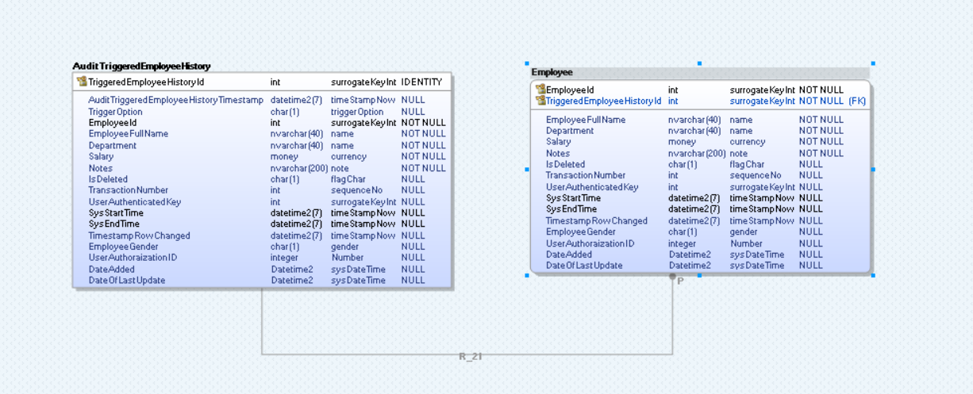
1 to 1 relationships

Slide 3
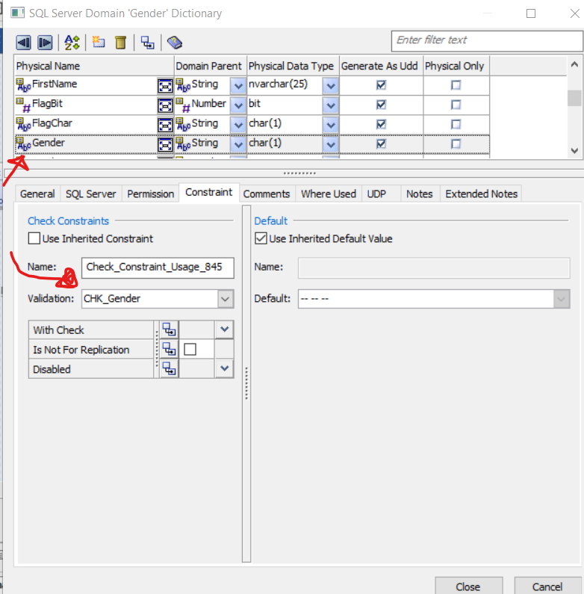
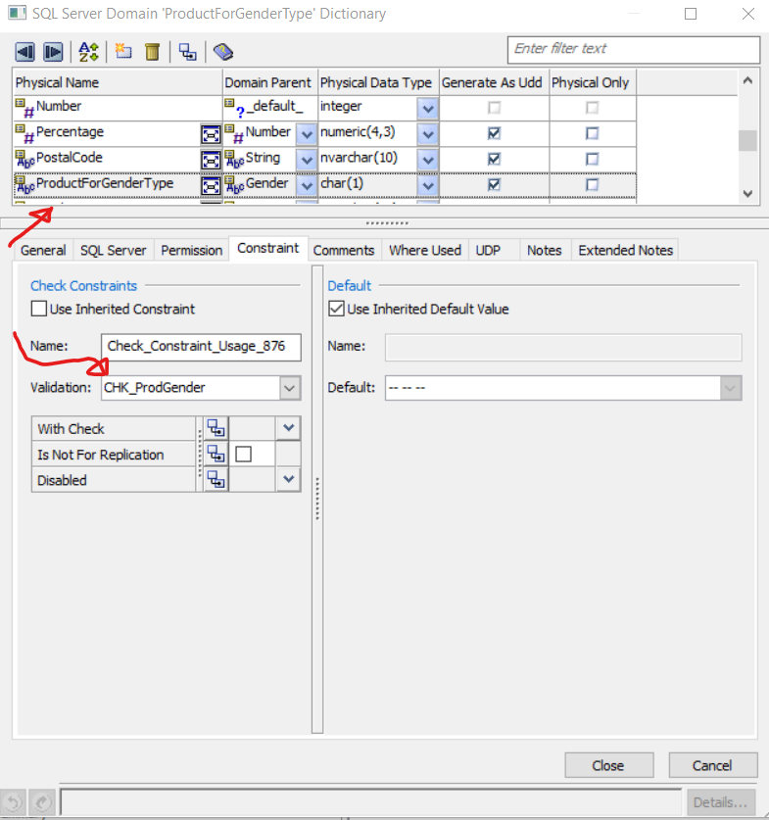
UDT / Creation process

Slide 4
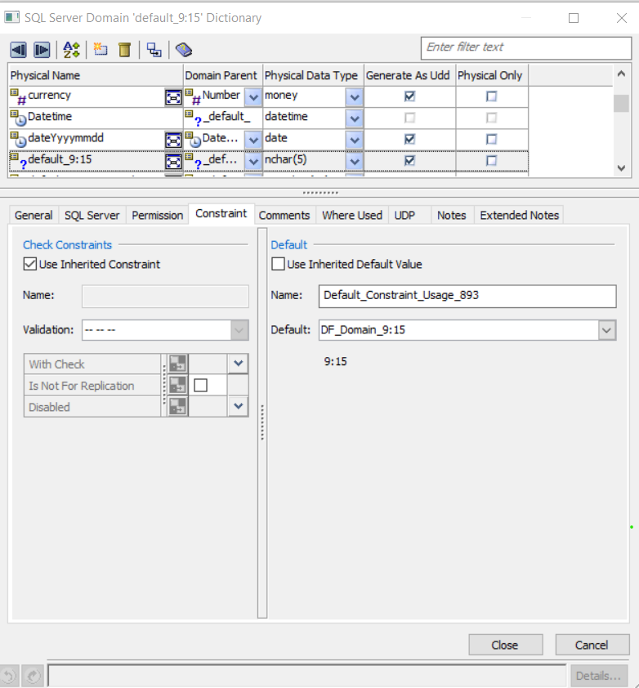
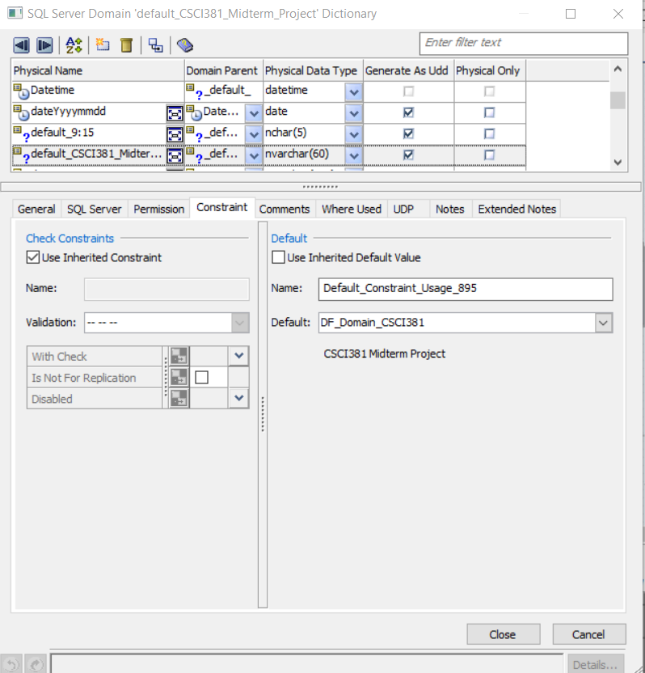
More UDT

Slide 5
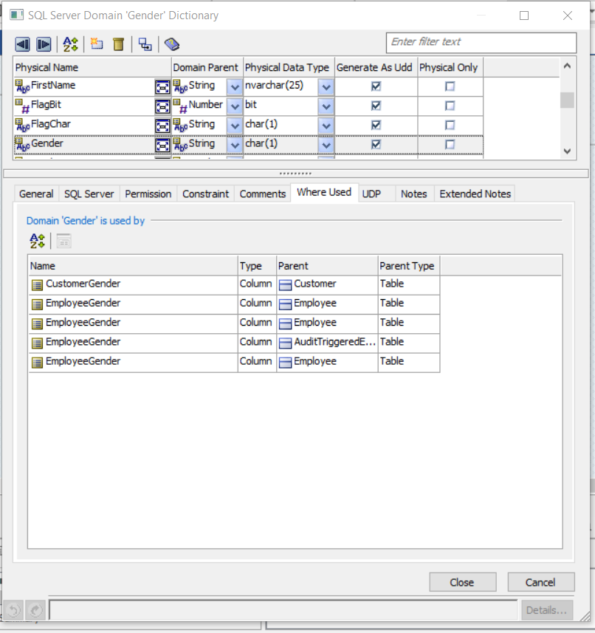
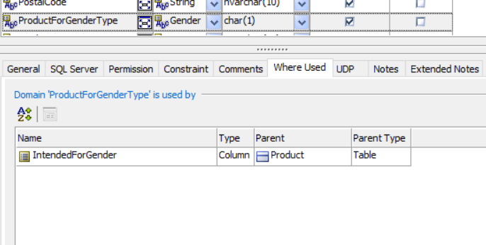
UDT USED LOCATIONS

Slide 6
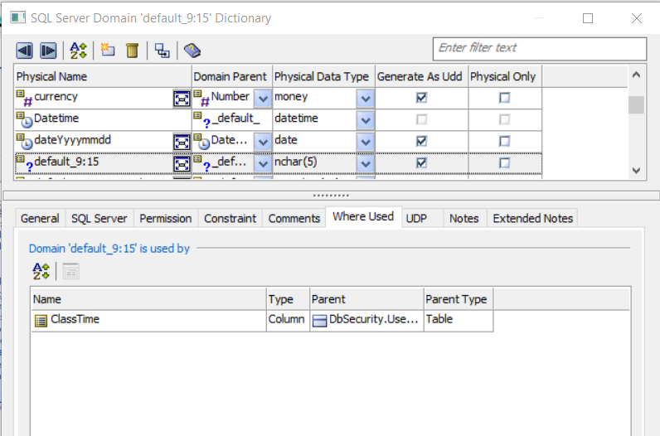
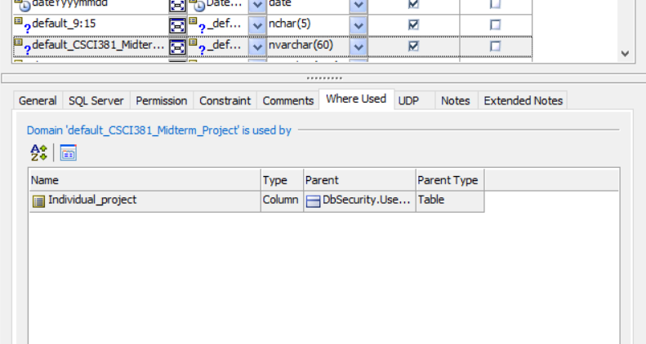
More UDT USED LOCATIONS

Slide 7
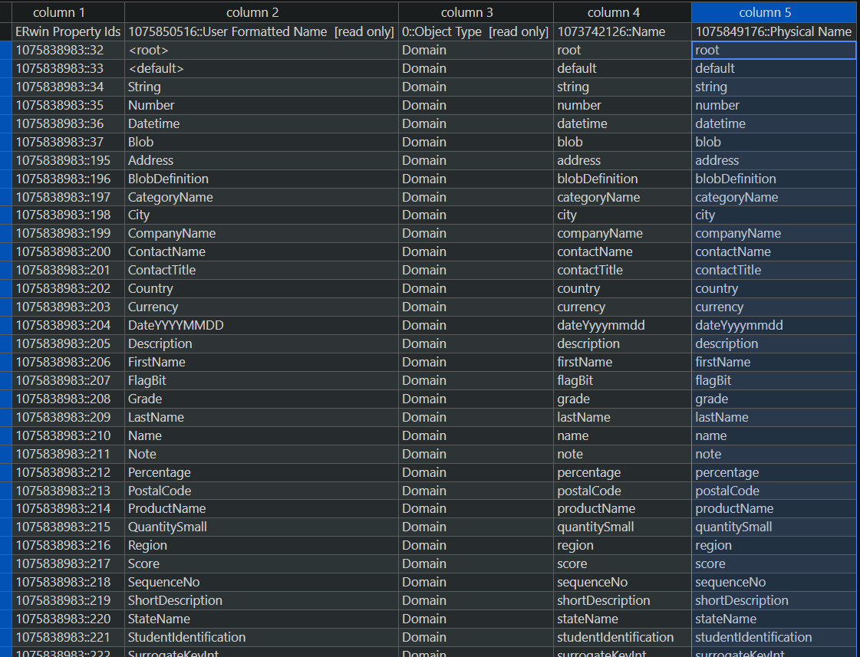
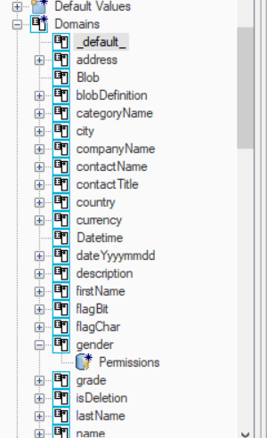
Refinement

Slide 8
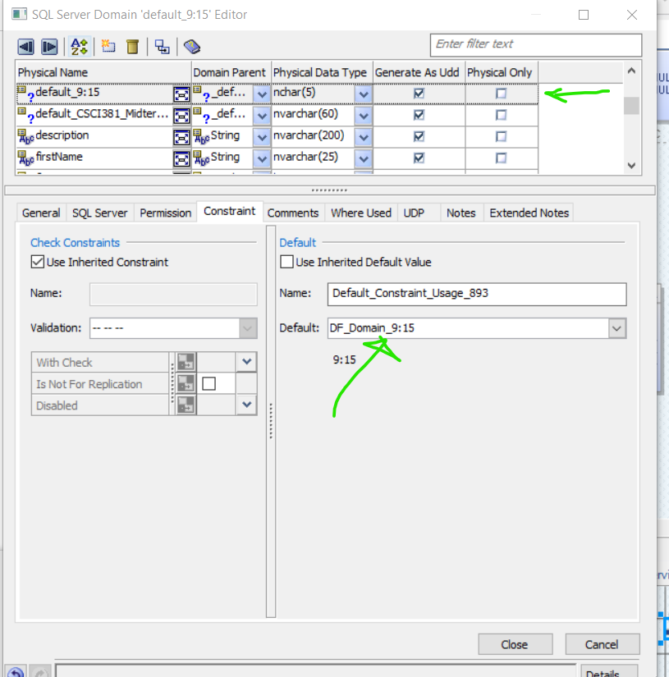
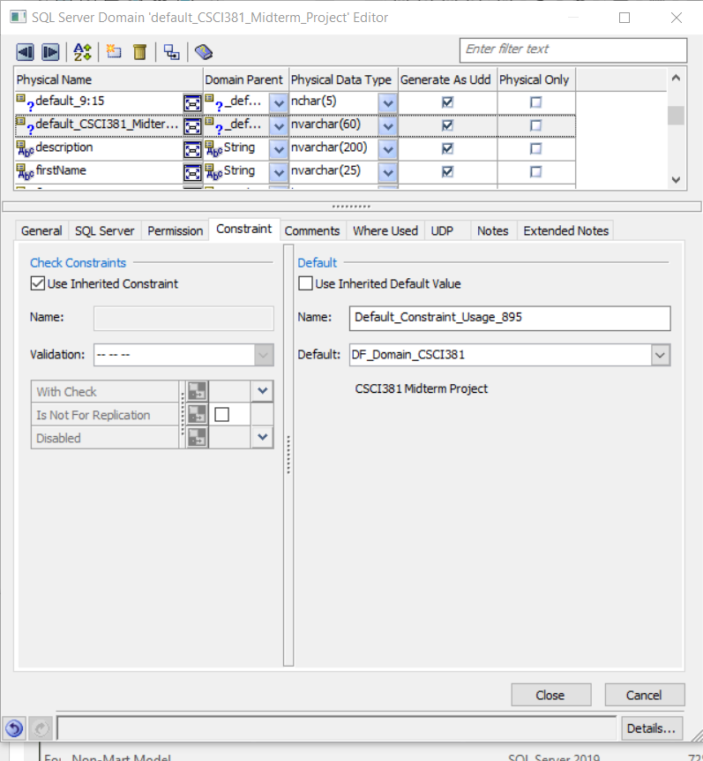
Data integrity / security (default values, validation, required)

Slide 9
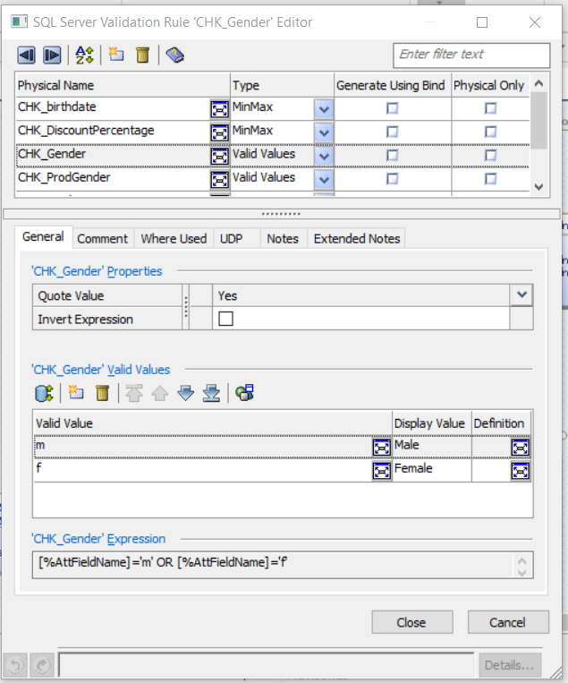
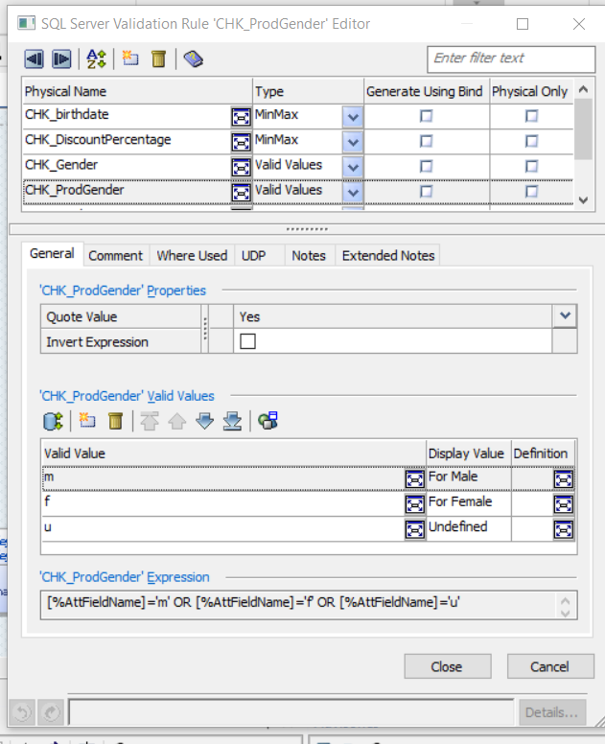
Validation Rules

Slide 10
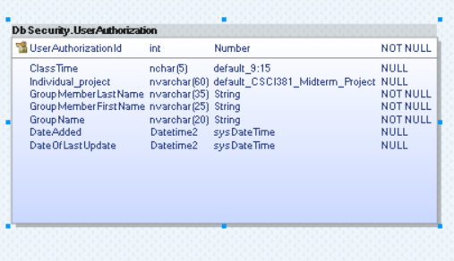
New entities

Slide 11
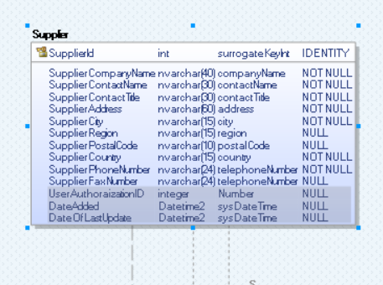
Adding 3 columns to all tables (multi select feature)

Slide 12
Generating sql doc with redgate
Done through SSMS after right clicking on the database that a generation of document is required
Then within the options there will be create document with SQL doc which opens up the SQL doc software
Finally save the project

Slide 13
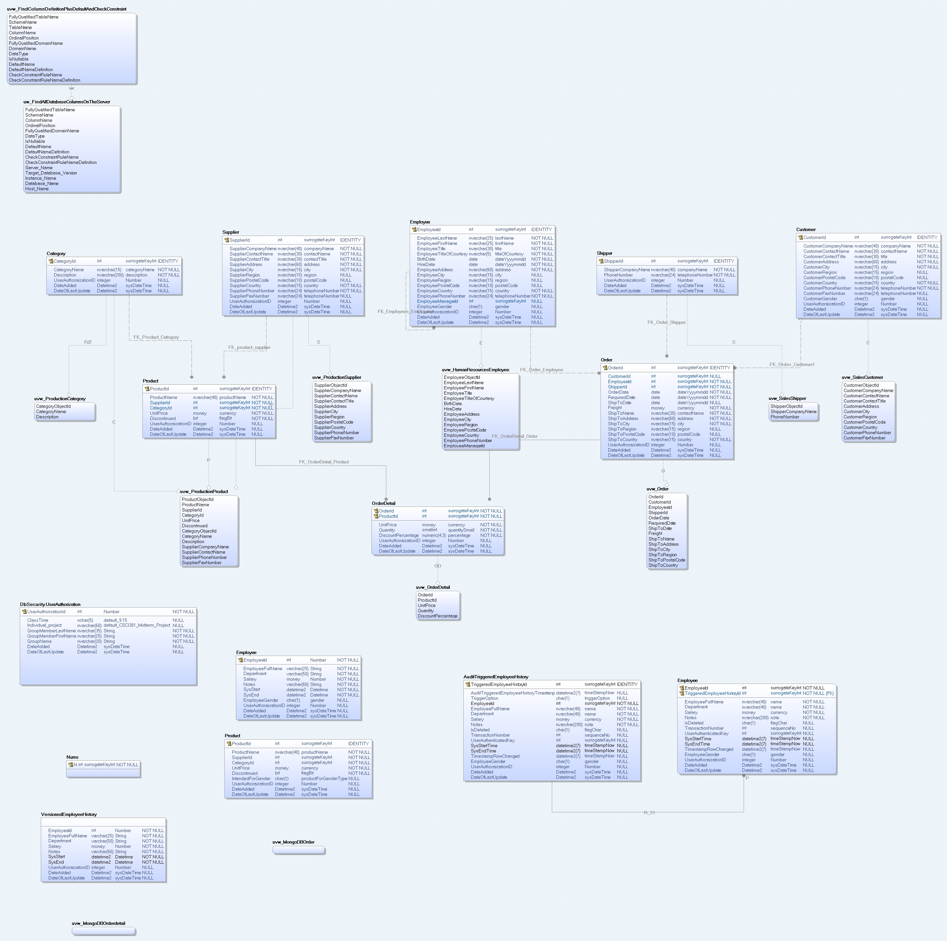
FULL DATABASE VIEW

